Slide 1
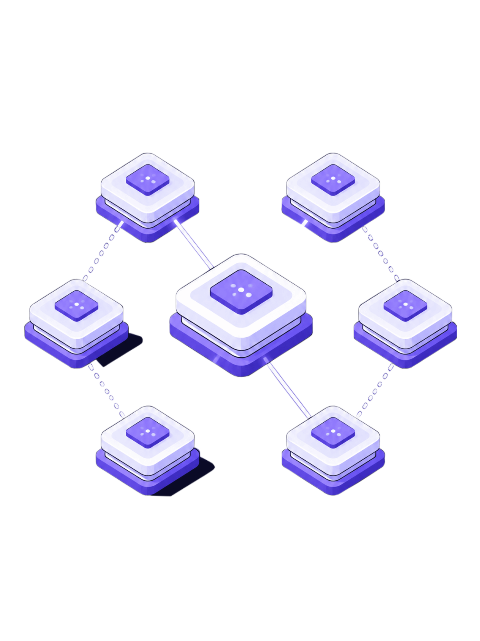

Vendor Reliability Intelligence & Procurement Risk Management Platform
Intelligent Vendor Evaluation and Procurement Decision Support
Vendors
Procurement
Performance Data
Reliability Intelligence
A comprehensive platform connecting vendor data, procurement workflows, performance metrics, and reliability intelligence to enable risk-aware procurement decisions at enterprise scale. Built with Angular, FastAPI, PostgreSQL, and modern DevOps tooling.

Slide 2
TEAM 1
TEAM MEMBERS
1
Jhansi Lakshmi
2
Likitha Tummapudi
3
Pratiksha Patil
Backend :
Frontend :
Frontend :
Authentication, authorization, user management, database / core backend configuration.
Login, registration, password management and frontend authentication.
Vendor management and dashboard UI.
4
Bhavyasree Kintala Backend :
5
Suchismita Dash
6
Yuvasri Palanikumar
Backend :
Frontend :
Vendor reliability, vendor management and performance.
Procurement workflow, purchase orders and contracts.
Procurement, purchase orders, contracts and related UI.
7
Sai Sree Nikitha
Backend :
Communications, notifications, reports, audit logs and messaging services.

Slide 3
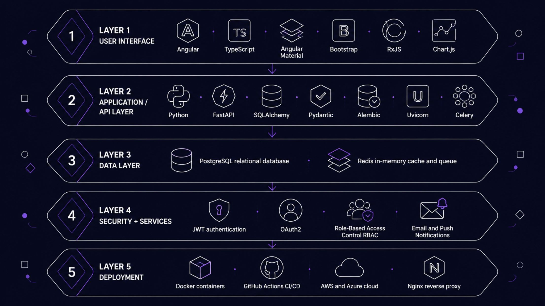
Technology Stack
A modern, layered full-stack architecture purpose-built for scalability, security, and procurement intelligence.
Frontend
Backend & Data
Angular 17 + TypeScript delivers a reactive, component-driven UI with Angular Material design system and Chart.js for in-app analytics visualizations.
Python FastAPI provides async REST APIs with full OpenAPI documentation. PostgreSQL handles relational persistence; Redis powers caching and Celery task queues for background jobs.

Slide 4
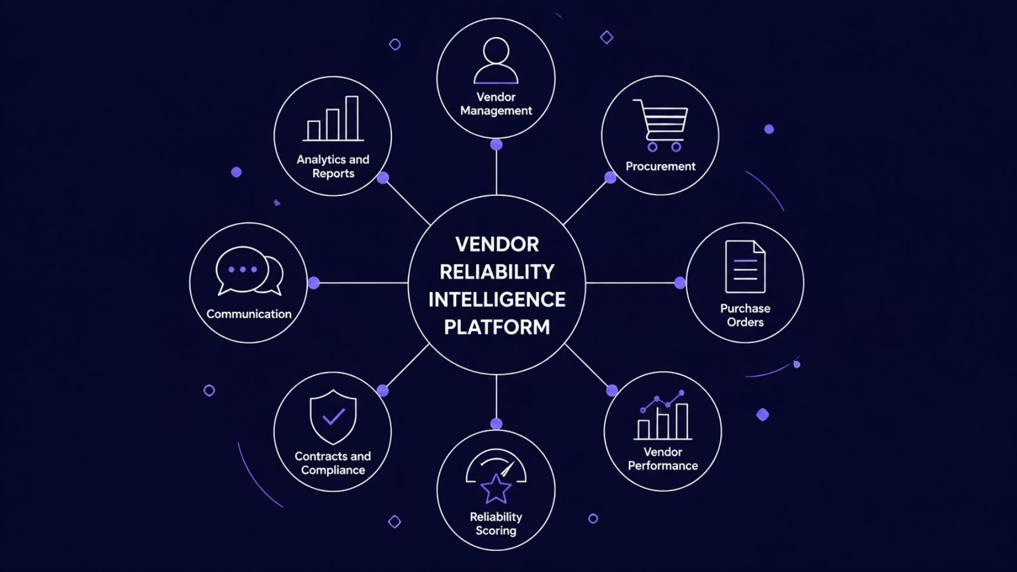
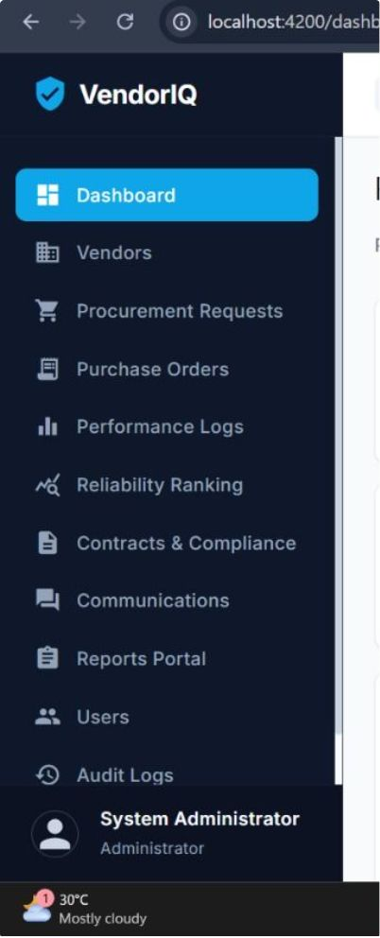
Core Features & System Modules
Ten integrated modules form a unified procurement intelligence ecosystem — each purpose-built, all interconnected.
Vendor Management
Reliability Scoring
Onboarding, profiles, approvals, and lifecycle tracking for all vendor relationships.
Composite scoring engine aggregating delivery, quality, compliance, and responsiveness metrics.
Procurement & POs
Analytics & Reports
End-to-end purchase request and purchase order workflows with role-based approvals.
Real-time dashboards and exportable reports for procurement managers, auditors, and finance.

Slide 5
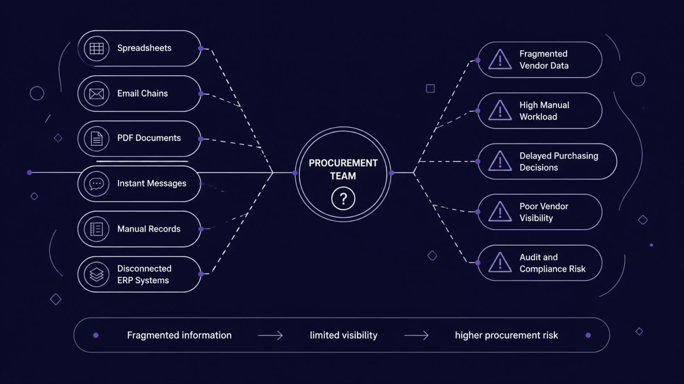
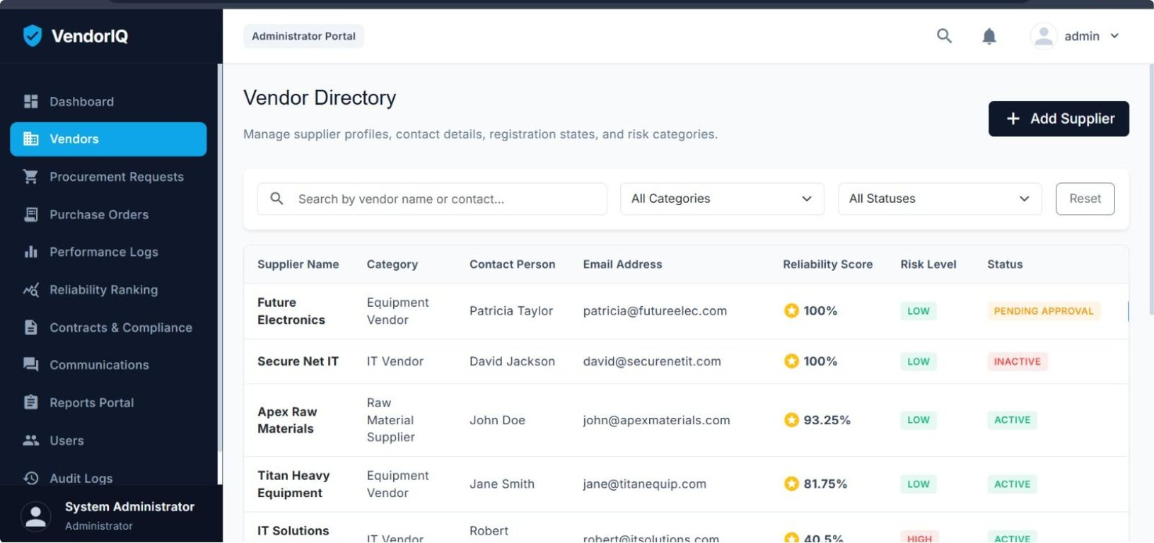
Challenges in Traditional Vendor & Procurement Management
Without a unified platform, procurement teams work in fragments — driving cost, risk, and slower decisions.

Slide 6
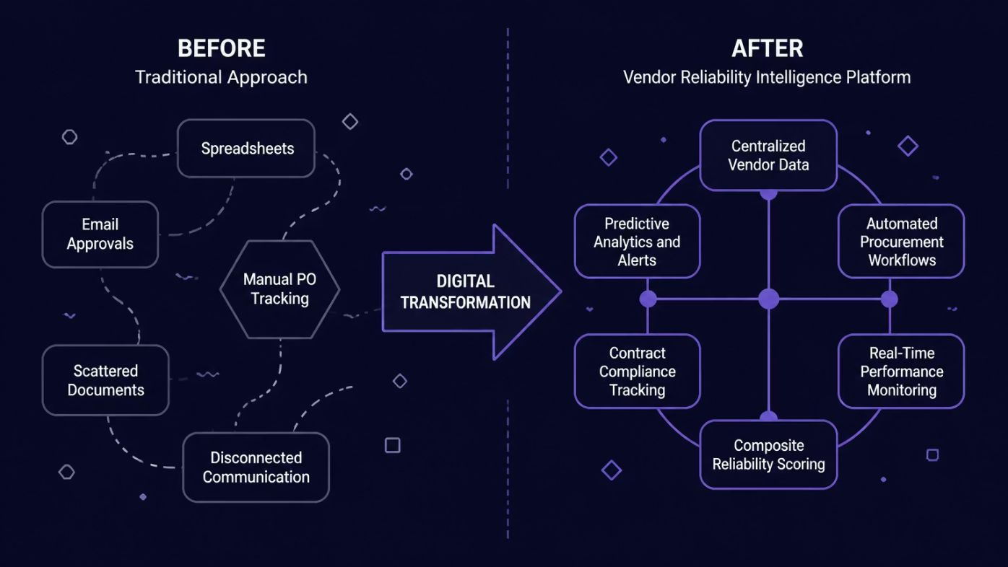
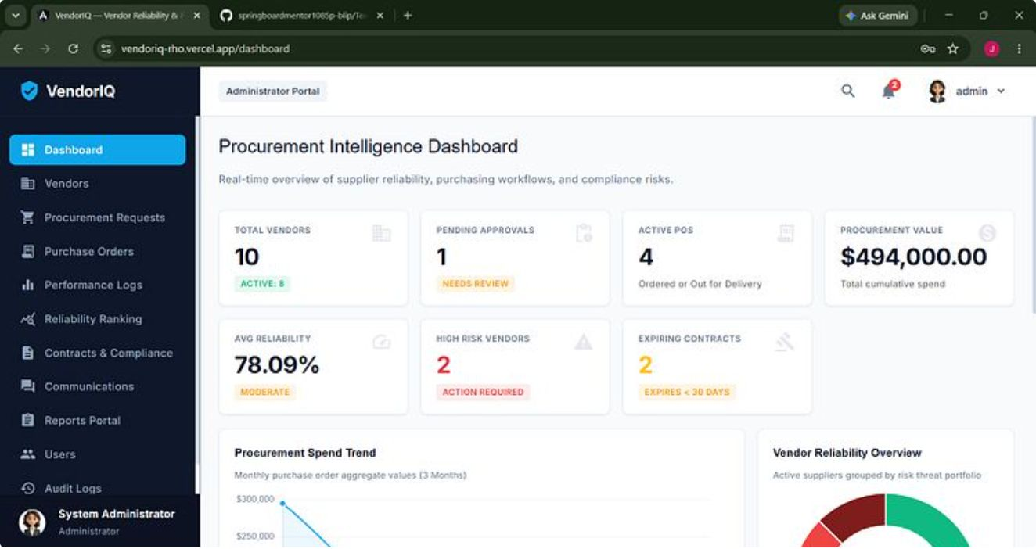



From Fragmented Processes to One Intelligent Platform
Unified Data
Automated Workflows
Intelligence Layer
Single platform consolidates all vendor, contract, and procurement records.
Role-based approvals, notifications, and task routing replace manual handoffs.
Reliability scoring and analytics surface risks before they become incidents.

Slide 7
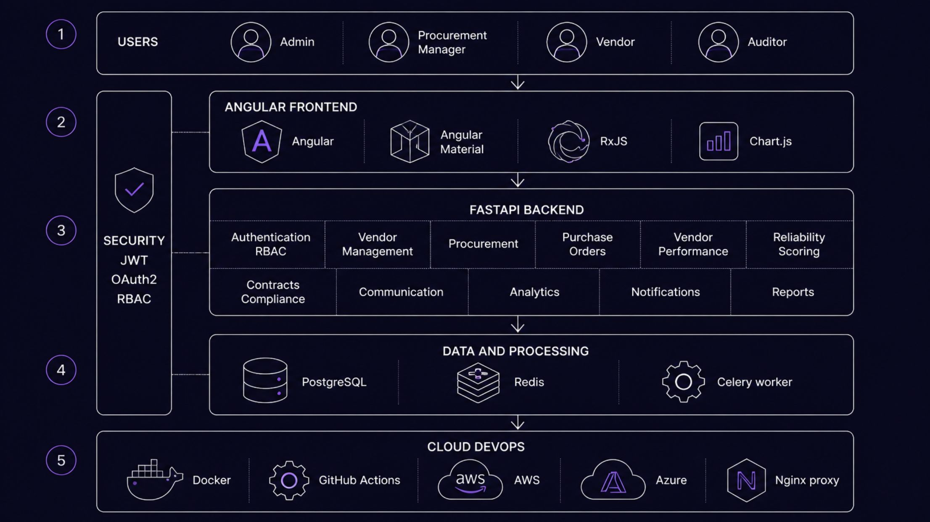
System Architecture
A five-layer architecture designed for security, modularity, and cloud-native deployment — with JWT/OAuth2/RBAC securing every API boundary.
API Design
Security Model
FastAPI delivers async REST endpoints with auto-generated OpenAPI/Swagger docs. Every module is independently versioned and testable.
JWT bearer tokens + OAuth2 flows authenticate every request. RBAC enforces six distinct role profiles — Administrator, Procurement Manager, Supply Chain Manager, Vendor, Finance Officer, and Auditor — each with scoped permissions.

Slide 8
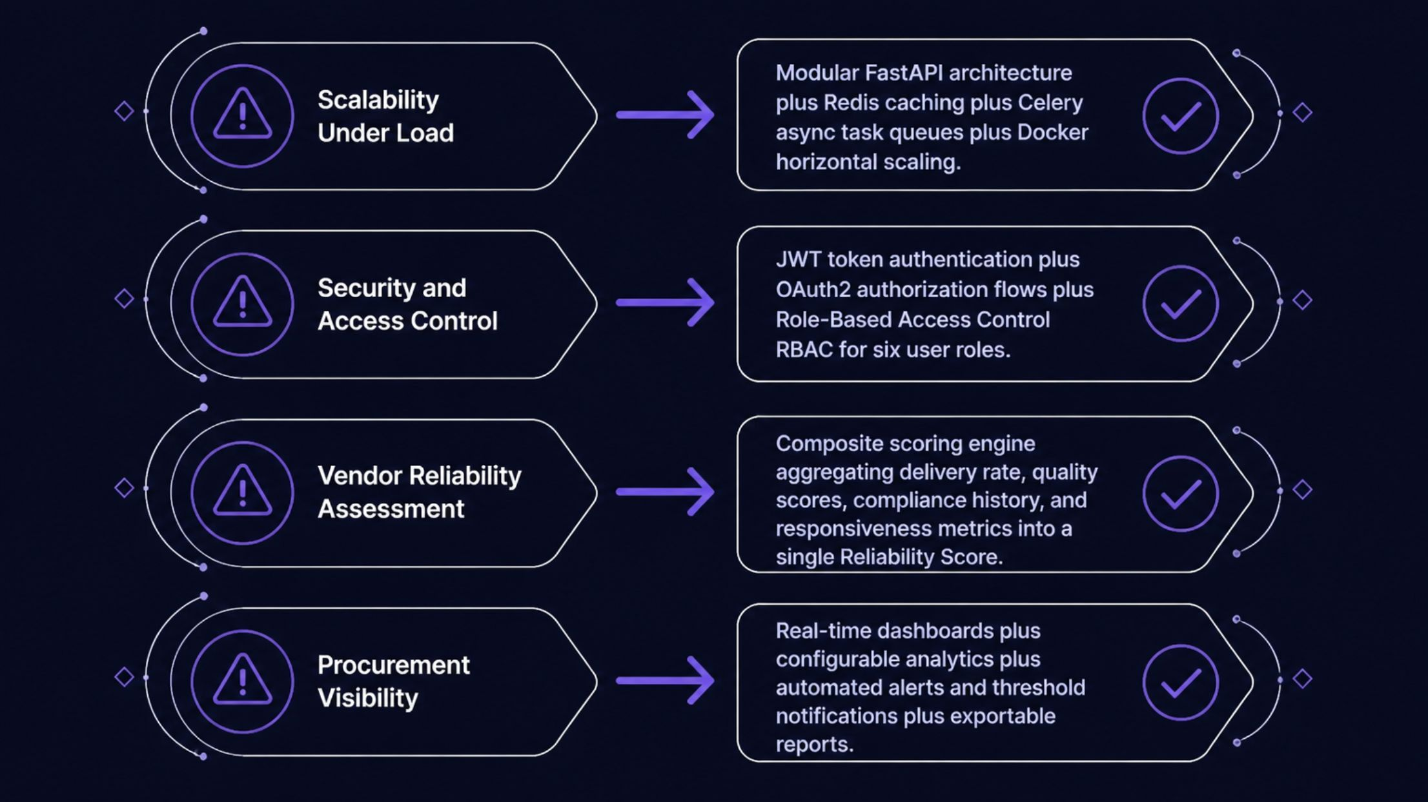
Engineering Challenges & Solutions
Four principal engineering challenges shaped the platform's technical design — each addressed with a targeted, production-grade solution.
Modular Codebase
Async Processing
Composite Scoring
Domain-separated FastAPI routers enable independent development, testing, and deployment of each platform module without cross-module coupling.
Celery workers offload long-running tasks — reliability recalculation, report generation, and bulk notifications — from the synchronous request cycle.
Reliability Score synthesizes on-time delivery %, quality rejection rate, compliance adherence, and communication responsiveness into a single vendor risk indicator.

Slide 9

Measurable Outcomes & Performance Targets
The following targets are project-defined design goals established during architecture and requirements planning — not measured production metrics.
<3min
<24hr
Vendor Registration
PO Approval Cycle
Target time from form submission to system confirmation for new vendor onboarding.
Target end-to-end purchase order approval turnaround through role-based workflow routing.
95%
<300ms
On-Time Delivery Monitoring
API Response Target
Platform monitors and surfaces delivery performance against this target threshold for each vendor.
FastAPI async endpoints with Redis caching designed to respond under 300ms for standard queries.
<2sec
1000+
Dashboard Load Target
Concurrent Users
Angular lazy-loading and optimized API aggregations designed to render dashboards in under 2 seconds.
Docker-containerized deployment with horizontal scaling supports 1,000+ simultaneous platform users.
These are project-defined performance targets set during system design and requirements engineering — they represent the intended operational envelope of the platform, not benchmarked production measurements.

Slide 10

End-to-End Vendor & Procurement Workflow
The platform guides every stakeholder through a structured, role-aware workflow — from initial login through performance scoring and executive reporting.
Login
Role Dashboard
Vendor Register
Vendor Approve
01
01
Initiation
Fulfillment & Tracking
Users authenticate via JWT/OAuth2 and land on a role-filtered dashboard. Vendors self-register; procurement teams submit sourcing requests.
Vendors update order status; the platform tracks delivery against promised dates, triggering alerts for delays or SLA breaches.
02
02
Procurement Execution
Intelligence & Reporting
Approved vendor requests generate purchase orders, routed through configurable approval chains to Supply Chain and Finance Officers.
Completed orders feed the reliability scoring engine. Aggregated performance data populates executive dashboards and compliance audit trails.

Slide 11
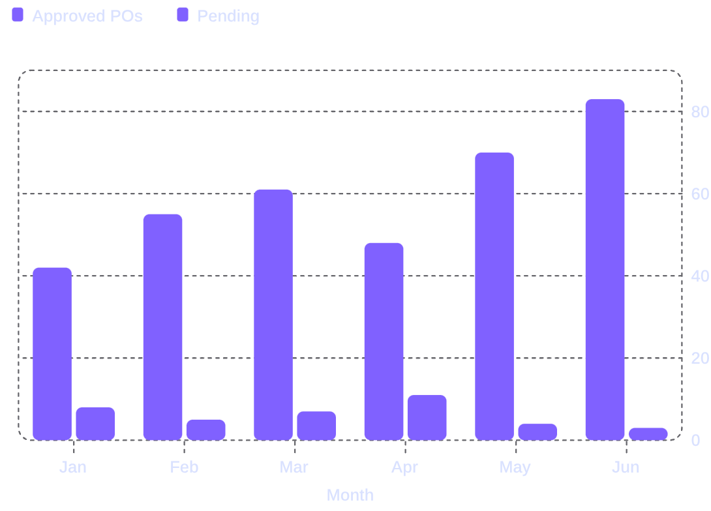
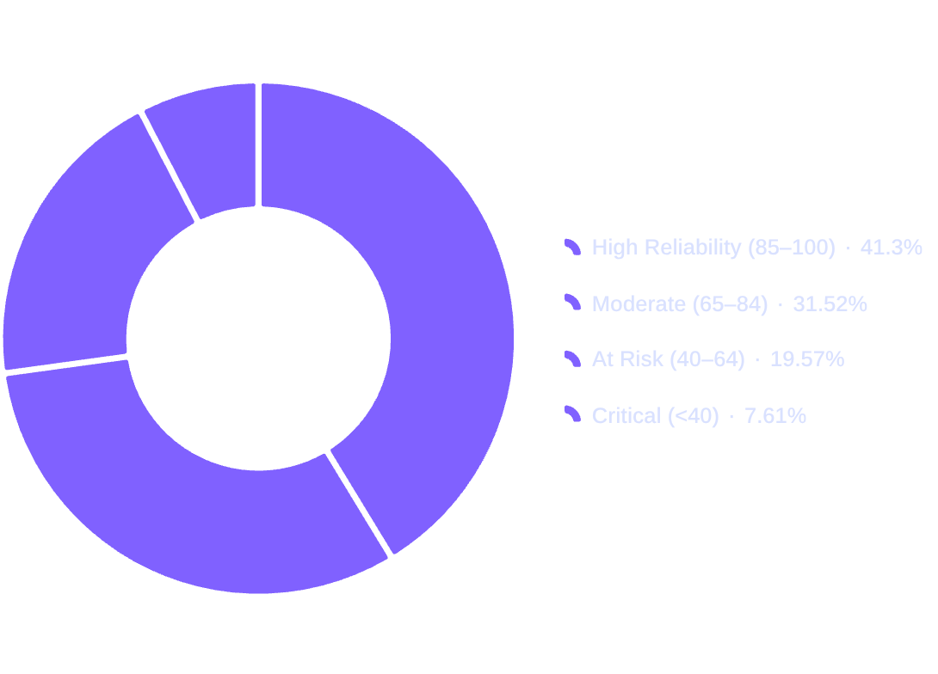
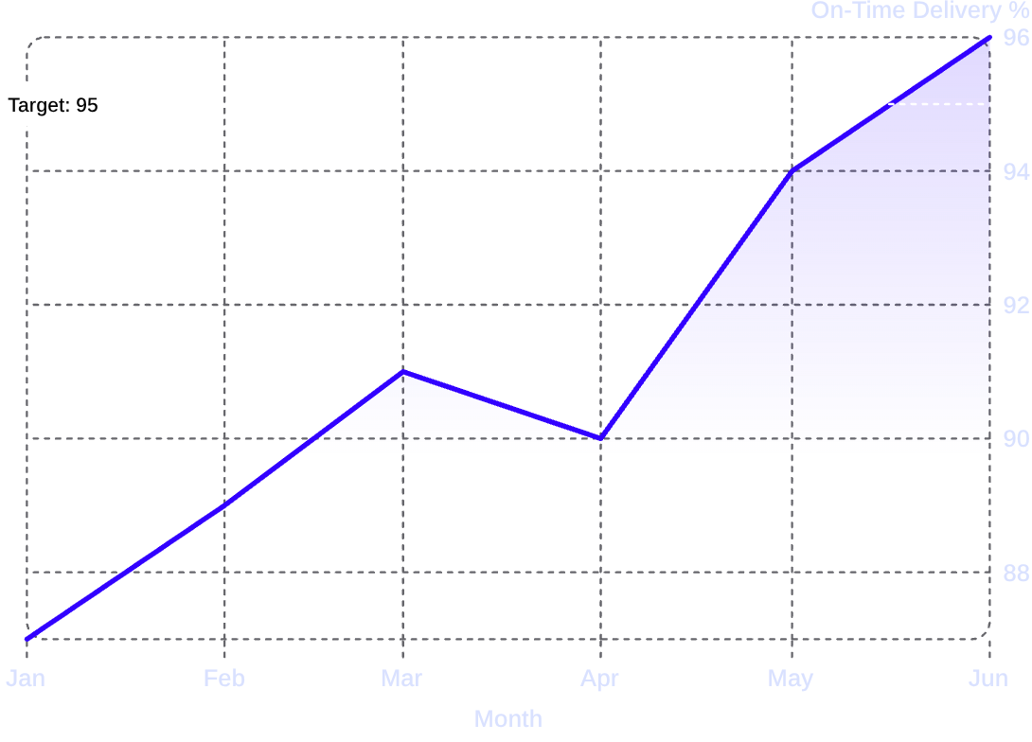
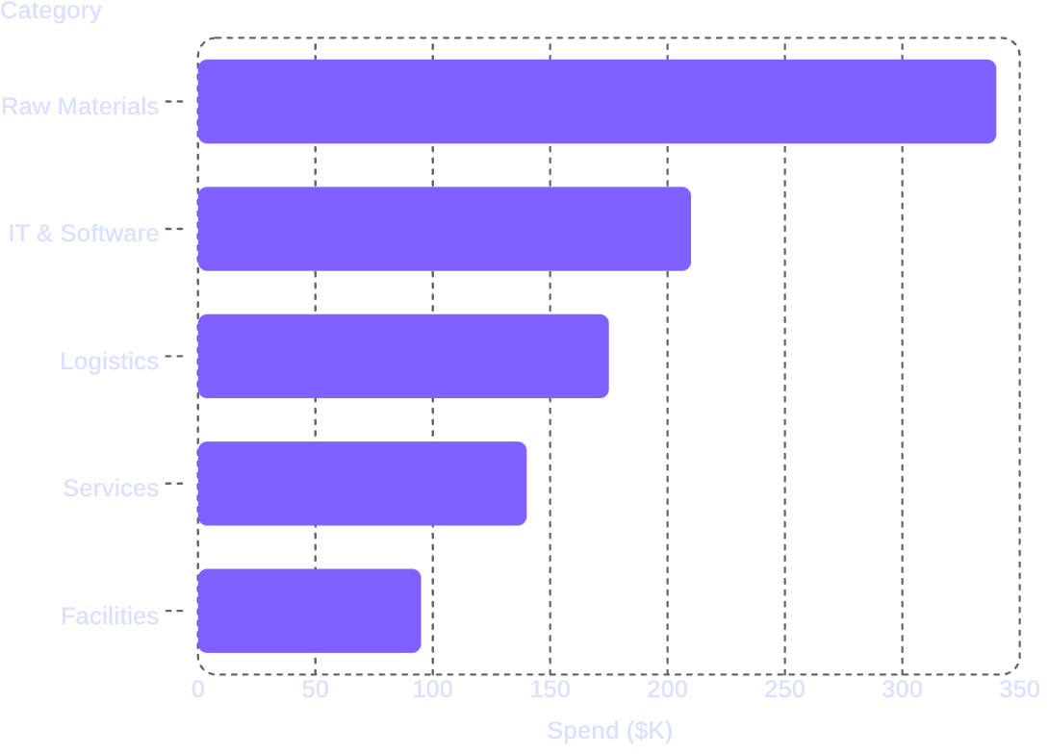
Intelligent Dashboards & Analytics
Three role-specific dashboards surface the right information to each user persona — from operational procurement tracking to executive compliance oversight.
Procurement Dashboard
Vendor Reliability Score Distribution
Active PO status, approval pipeline, and monthly procurement volume trends — available to Procurement Managers in real time.
Composite reliability score distribution across the vendor portfolio — enabling procurement teams to prioritize sourcing from high-confidence suppliers.
On-Time Delivery Trend
Procurement Spend by Category
Platform-wide on-time delivery performance tracked against the 95% SLA target — surfaced on the Admin Dashboard for compliance and audit reporting.
Spend analytics by procurement category — available to Finance Officers for budget planning and cost optimization within the Admin Analytics module.

Slide 12
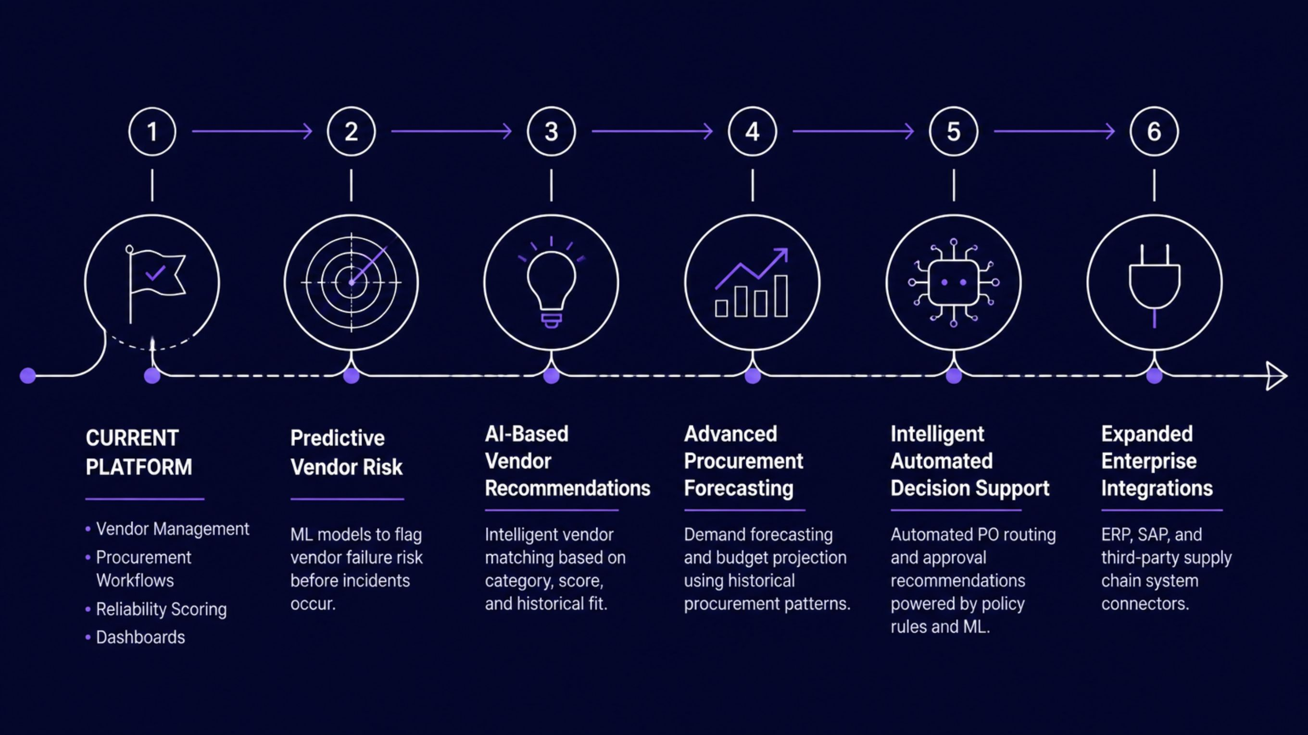
Future Enhancements & Roadmap
The platform's modular architecture provides a clear runway for AI-augmented procurement intelligence — building progressively on the current foundation.

Slide 13
THANK YOU

